Slide 1




Slide 2
End-Sem Project Presentation
Instant feedback system using Face recognition
Presented By:
Deepesh Singh , SAPID : 500106971
Abhishek Kumar, SAPID : 500106851
Omji Shukla, SAPID : 500100963
Mentor :
Miss Saroj Shivagunde
School of Computer Science | UPES

Slide 3
Table of content
Introduction
Objectives
Literature
System Design
Result and Outputs
Future Enhancement
References

Slide 4
Introduction
Face detection and emotion analysis have revolutionized diverse sectors, from security and healthcare to entertainment and customer experience
These technologies offer a window into the incredible possibilities of artificial intelligence and machine learning
The purpose of this project is to help various restaurants, malls and other shops to get a real time review of their services from their customers by reading their Face expression

Slide 5
Objective
Implement advanced computer vision techniques, including Face detection, recognition, and emotion analysis, to enable real-time tracking of customer sentiments
Provide businesses in various industries, including restaurants, malls, art galleries, and transportation services, with a comprehensive solution to enhance customer experiences

Slide 6
Literature
Foundational Paper:
A Convolutional Neural Network Cascade for Face Detection
Deep learning using Face recognition:
Face Expression Recognition
Real-Time Emotion Detection:
Real-time Convolutional Neural Networks for Emotion and Gender Classification
A Multi-Task Neural Approach for Emotion Attribution, Classification, and Summarization

Slide 7
System Design
Video Input
Facial Detection
Facial Recognition
Facial Expression Analysis

Slide 8
Flow of the project
IMAGE / VIDEO SOURCE
FACE DETECTION
FACE RECOGNITION
EMOTION DETECTION
STORE STATS IN DATABASE
CALCULATE RESULT

Slide 9
Result and Outputs
The integration of facial recognition and emotion analysis will significantly improve user experiences across diverse sectors, retail, and customer service
The project will encompass real-time emotion detection (HAPPY, SAD, NEUTRAL, ANGRY, SURPRISED) while contributing to sectors such as restaurants, art galleries, and certain exhibitions where timely and accurate responses are crucial

Slide 10
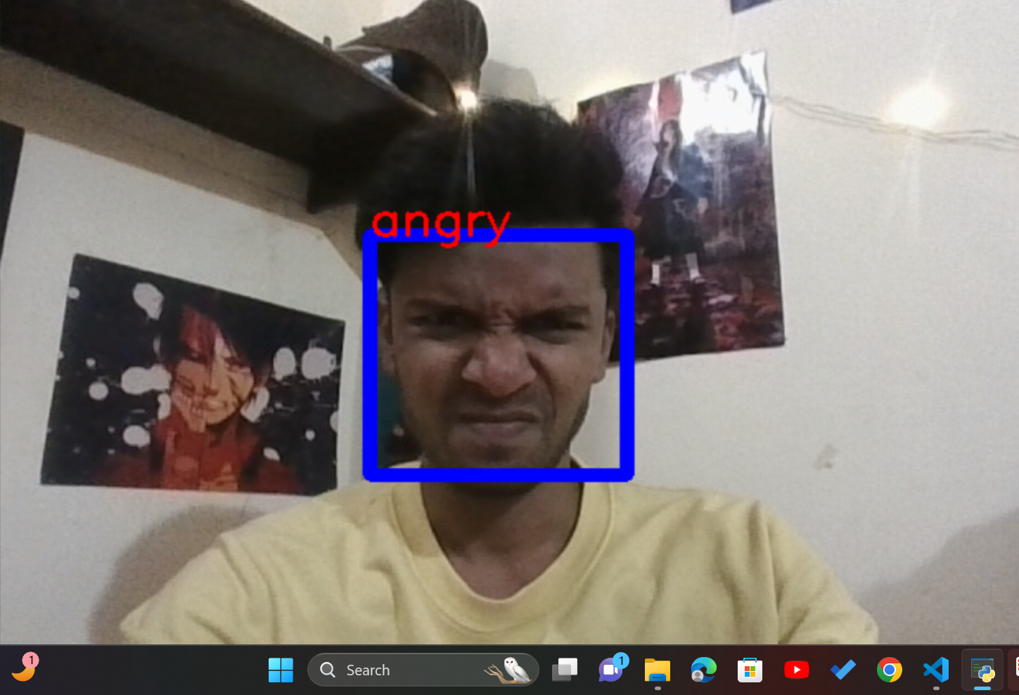

Slide 11
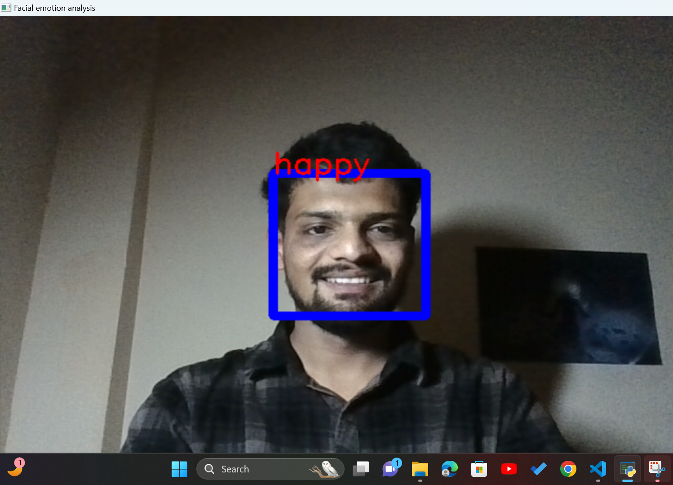

Slide 12
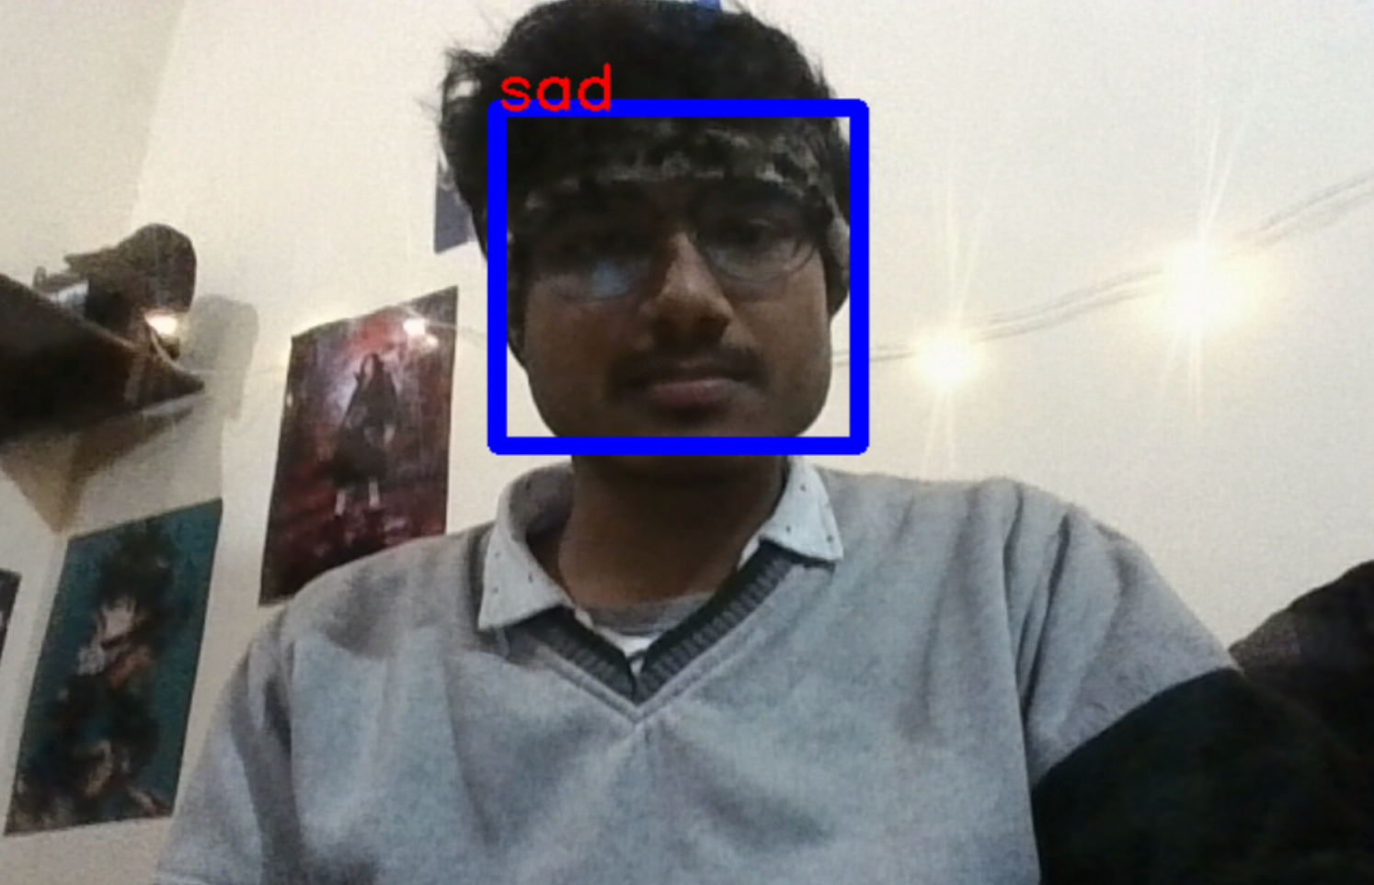

Slide 13
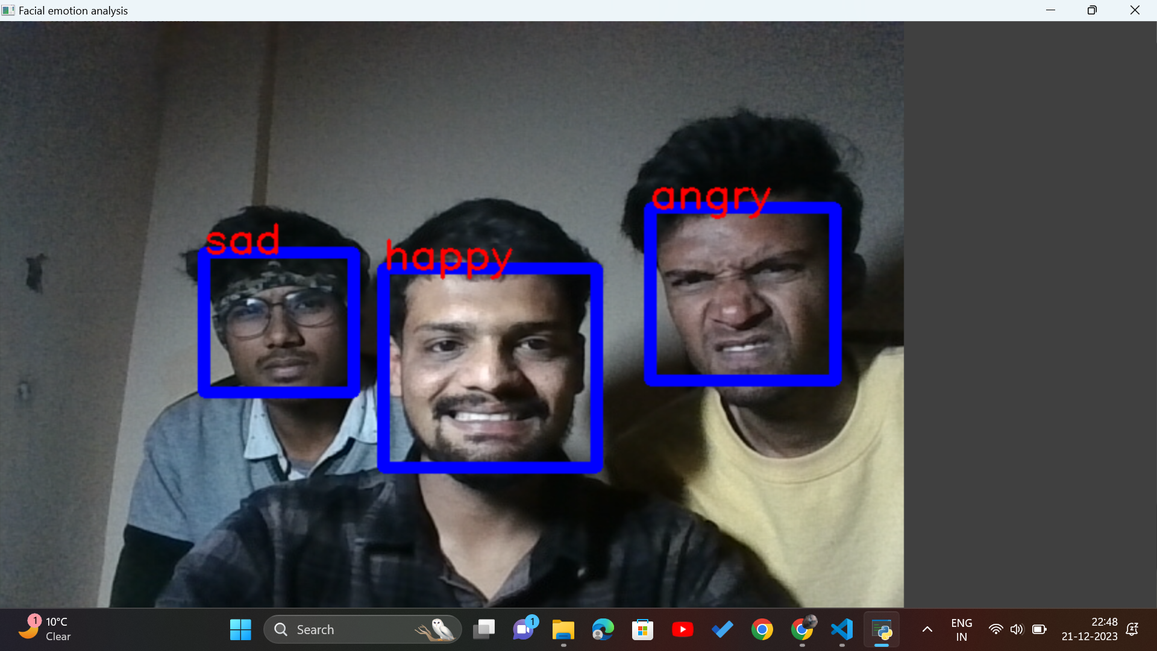

Slide 14
Future Enhancement
Multi-Modal Emotion Recognition: Voice analysis or gesture recognition
Applying the system to enhance emotional interactions between humans and robots

Slide 15
Reference
Research Papers :
A Convolutional Neural Network Cascade for Face Detection : Haoxiang Li, Zhe Lin, Xiaohui Shen, Jonathan Brandt, Gang Hua; Proceedings of the IEEE Conference on Computer Vision and Pattern Recognition (CVPR), 2015, pp. 5325-5334
Face Expression Recognition : Face Expression Recognition: A Brief Tutorial Overview Claude C. Chibelushi, Fabrice Bourel Chibelushi, C.C. and Bourel, F., 2003. Face expression recognition: A brief tutorial overview. CVonline: On-Line Compendium of Computer Vision, 9
Real-time Convolutional Neural Networks for Emotion and Gender Classification : Arriaga, Octavio, Matias Valdenegro-Toro, and Paul Plöger. "Real-time convolutional neural networks for emotion and gender classification." arXiv preprint arXiv:1710.07557 (2017)
A Multi-Task Neural Approach for Emotion Attribution, Classification, and Summarization : G. Tu, Y. Fu, B. Li, J. Gao, Y. -G. Jiang and X. Xue, "A Multi-Task Neural Approach for Emotion Attribution, Classification, and Summarization," in IEEE Transactions on Multimedia, vol. 22, no. 1, pp. 148-159, Jan. 2020, doi: 10.1109/TMM.2019.2922129
Books:
"Practical Python Projects" by Lee Vaughan (Chapter on Computer Vision)
"Computer Vision: Algorithms and Applications" by Richard Szeliski

Slide 16
THANK YOU

